Slide 1

Early Prediction of Neonatal Hypoxic-Ishemic
Encephalopathy with Interactive GUI Integration
Apoorva
NNM24MC017

Slide 2
INTRODUCTION
HIE is brain injury from low oxygen
It causes disability and death in newborns
Early treatment within six hours works best
Diagnosis is hard due to vague symptoms

Slide 3
PROBLEM STATEMENT
MRI and EEG are not always available
Early signs of HIE are often unclear
Lack of tools for real-time hospital use
A simple, accessible tool is needed

Slide 4
OBJECTIVES
Build a model to predict HIE early
Use Random Forest for high accuracy
Create a GUI for easy hospital use
Support faster neonatal interventions

Slide 5
LITERATURE REVIEW
PAPER TITLE | AUTHOR | YEAR
Machine learning for forecasting initial seizure onset in neonatal hypoxic–ischemic encephalopathy | Danilo Bernardo, Jonathan Kim, Marie-Coralie Cornet, Adam L. Numis, Aaron Scheffler, | 2025
EEG Spectral Power and Neurovascular Coupling as Early Predictors of Neurodevelopmental Outcome in Neonatal Hypoxic-Ischemic Encephalopathy | Srinivas Kota, Yu-Lun Liu, Lynn Bitar, | 2024
Automated Neuroprognostication Via Machine Learning in Neonates with Hypoxic-Ischemic Encephalopathy | Lewis et al., Annals of Neurology | 2024

Slide 6
DATASET
Data collected at Father Muller Hospital
Included maternal, birth, and neonatal data
Key features: Apgar, seizures, feeding, EEG
Data was anonymized, cleaned, and balanced

Slide 7
METHODOLOGY
Steps: collect → preprocess → train → GUI
Random Forest chosen for data handling
Data split: 80% train, 20% test
GUI built in Tkinter with color-coded output

Slide 8
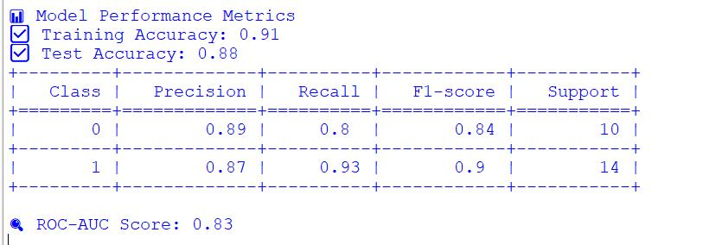
RESULTS

Slide 9
CHALLENGES
Dataset small and from one hospital
Affected by imbalance and missing values
GUI needs manual entry, risk of errors
Model may not generalize everywhere

Slide 10
CONCLUSION
Random Forest predicts HIE accurately
GUI makes it simple for doctors
Enables early neonatal risk detection
Enhances neonatal care in Indian hospitals

Slide 11
THANK YOU

